Slide 1
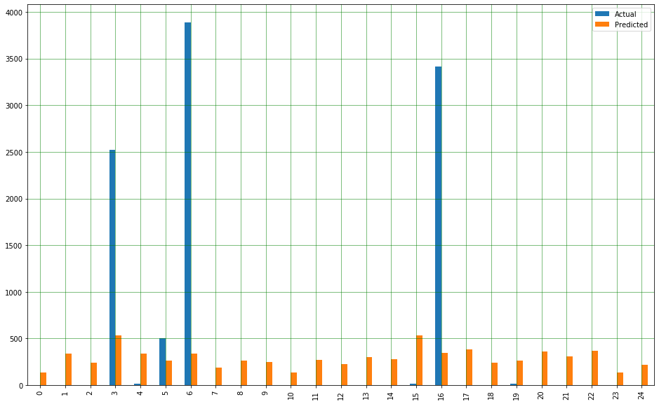
Predict time taken to answer the questions on StackOverflow Abhishek(MT19086),Chirag(MT19089),Mansi(MT19092)
Advisor: Dr. Tanmoy Chakarborty,IIIT Delhi
Problem Defination
Baselines
Results
The problem is to predict the answering time of particular question.
Preprocessing:
Remove NaN values
Remove HTML tags
Merging data frames
Remove Stop words
Tokenisation
Stemming
Mean Absolute Error :
Jaccard Coefficient : 593.14
Linear Regression : 481.95
TF-IDF : 392.99
Mean Squared Error :
Jaccard Coefficient : 593.14
Linear Regression : 481.95
Dataset
Dataset
Consist of questions,tags and answers table.
Question : consist of creation date, closing date , body, title, owner id.
Answer : body, creation date, score, owner id.
Tags:Tags for question
Models
Feature Engineering
Jaccard Coefficient
Tf-idf
Proposed solution and future work
The problem is to predict the time taken to get the answer of particular on StackOverflow We are using following baseline techniques :.
Jaccard Coefficient : We are predicted jaccard score for the test data with train data and predicting time of test questions, and calculating Mean Absolute Error :
TF-IDF : Next we are finding the similarity of test question data with train question data using tf-idf based similarity, and predict the time of test question data based on the similar train questions and we are calculating mean absolute error : 374.69 hrs.
In the future work we will take care of score,tags and other feature that may affect the prediction time of question .
We will also try to exploit Relevance feedback techniques to improve the estimated answering time and advanced methods as cluster pruning to handle large dataset.
Actual Vs predicted time
in linear Regression

